Slide 1
BDAA Spring ’17 Workshop Series iI: Data Munging
How to clean, manipulate, and expand data

Slide 2
What is Data Munging?

Slide 3
Data Munging Definition:
“Data munging or data wrangling is loosely defined as the process of manually converting or mapping data from one "raw" form into another format that allows for more convenient consumption of the data with the help of semi-automated tools.”
Parsing, Tokenizing, Converting
“Data cleansing, data cleaning, or data scrubbing is the process of detecting and correcting (or removing) corrupt or inaccurate records from a record set, table, or database and refers to identifying incomplete, incorrect, inaccurate or irrelevant parts of the data and then replacing, modifying, or deleting the dirty or coarse data.”
Batch processing, Applying schema, Correcting / removing errors
AKA: THE CRAP WE DON’T WANT TO DO.
* CAN BE UP TO 80-90% OF THE WORK / COST OF A PROJECT! *

Slide 4
WHEN IS MY DATA CLEAN ?!#%!&#%@
Depends!
Do you care about extraneous data?
Is it worth your time to make certain things “prettier”?
STANDARD(when possible):
1 column = 1 variable
1 row = 1 observation

Slide 5
EXAMPLEs:
Cleansing (often first)
Validating restraints (types, range, etc.)
Checking completeness (database doesn’t accept NULL?)
Outliers
Eliminating duplicates
Munging (can be simultaneous):
Parsing JSON into a usable format
Changing data formats (spoiler alert!)
Making disparate datasets play nice
Adding additional data (coordinates, calculated fields, sentiment – spoiler!, etc.)

Slide 6
METHODS
Software
Talend
Plain Code
SQL, R, Python
Packages / Functions
R: dplyr, tidyr, lubridate (spoiler!)
BE LAZY!
Don’t reinvent the wheel: use stackoverflow, R forums, youtube, professors, R documentation, ME
BUT: Don’t simply repurpose
Cheat sheets are great!

Slide 7
LET THE GAMES BEGIN!
github.com/kalmanroemer/BDAAEducation

Slide 8

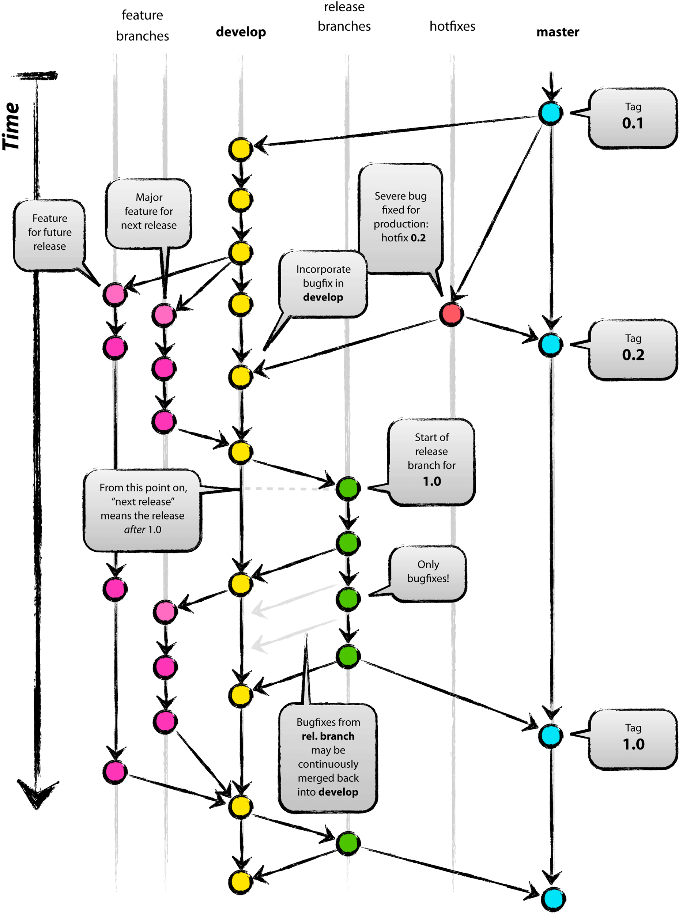
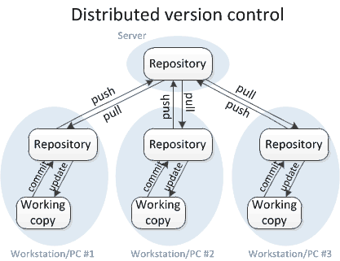
BONUS: Version Control
“the management of changes to documents, computer programs, large web sites, and other collections of information.”
Repositories cover your backside
“Branch/Fork”
“Clone”

Slide 9
Explore!
http://varianceexplained.org/r/trump-tweets/
https://www.r-bloggers.com/twitter-sentiment-analysis-with-r/
https://moz.com/followerwonk/oMjB

